Slide 1
Blood Visual Abstracts
Single-Field Visual Abstract Template
Notes:
Slide #1. Title

Slide 2
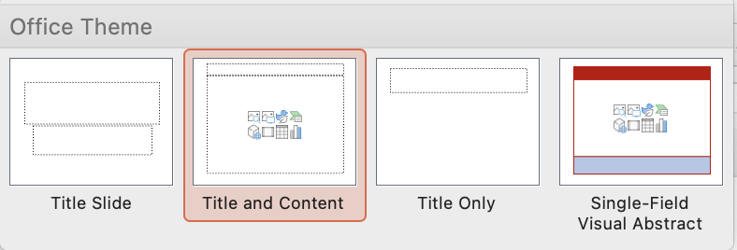
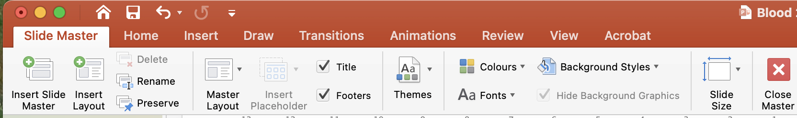
User Guide
This PowerPoint file has been conceived to help Blood Authors prepare their visual abstracts.
Slide #3 reports the Template for creating a single-field visual abstract (Layout->drop-down menu->Single-Field Visual Abstract):
You may modify the template, but please do not distort it substantially. To modify a PowerPoint template, you should click View and select Master->Slide Master. Duplicate an existing template, modify it, and save changes. Then, Rename the duplicated template (use a new name) and return to the normal View:
Top panel: Non-assertive, Capitalized Title That Defines the Topic for the Average Reader That the Journal Is Trying to Reach (and is not an expert in your field).
The central field should summarize the Context of research and the Main outcomes/findings: Please limit the text as much as possible and focus on the main points.
Bottom panel: Conclusions (1 or 2 Key Points) with DOI (this latter will be added by Blood staff during production).
Please use text sparingly and include clear images: Focus on the main points exclusively.
Your Visual Abstract will be peer-reviewed and you might be invited to modify/improve it before publication online.
Final edits/adjustments will be made in-house during production.
Notes:
Slide #2. User Guide

Slide 3
Notes:
Slide #3. Single-Field Visual Abstract Template

Slide 4
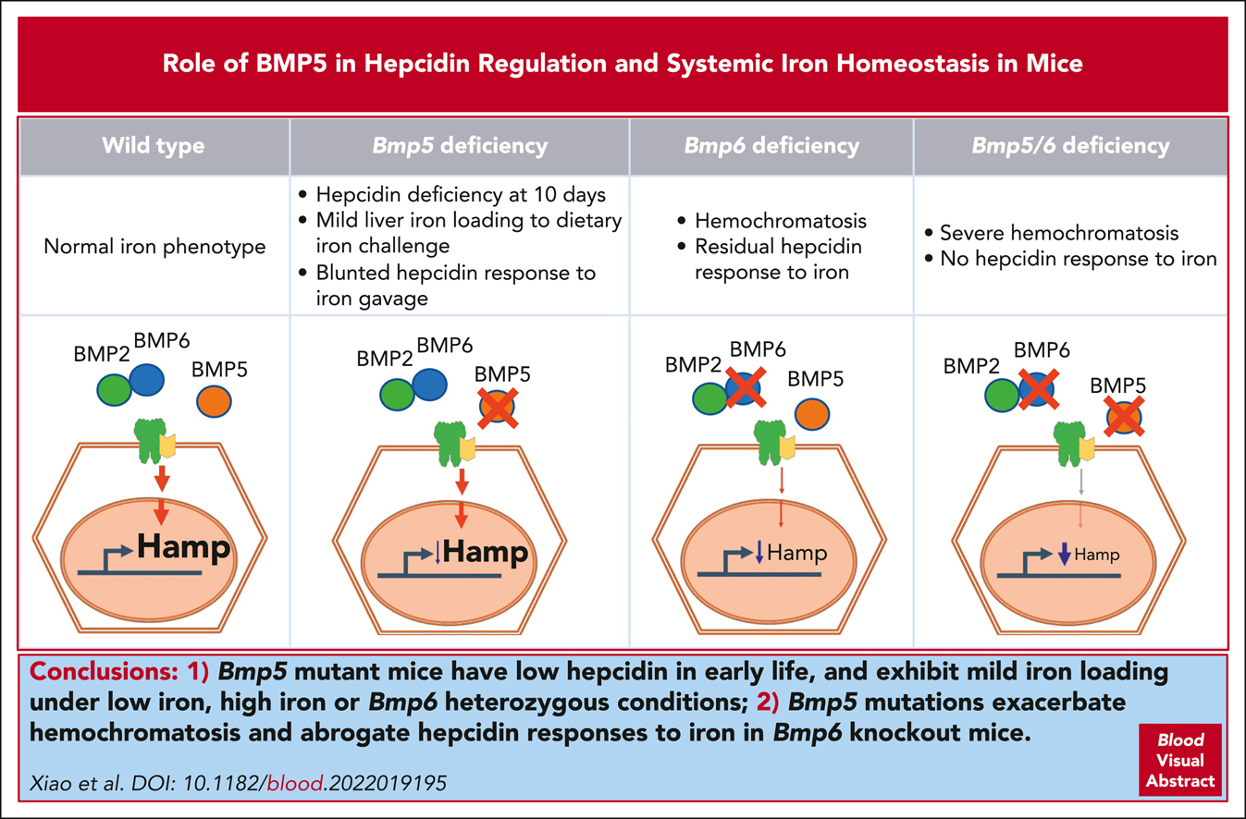

BMP5 contributes to hepcidin regulation and systemic iron homeostasis in mice
Xia Xiao,Yang Xu,Gillian A. Moschetta,Yang Yu,Allison L. Fisher,Víctor M. Alfaro-Magallanes,Shasta McMillen,Sydney Phillips,Chia-Yu Wang,Jan Christian,Jodie L. Babitt, BMP5 contributes to hepcidin regulation and systemic iron homeostasis in mice, Blood, 2023,
Copyright © 2023 American Society of Hematology
Notes:
Blood Research Article

Slide 5
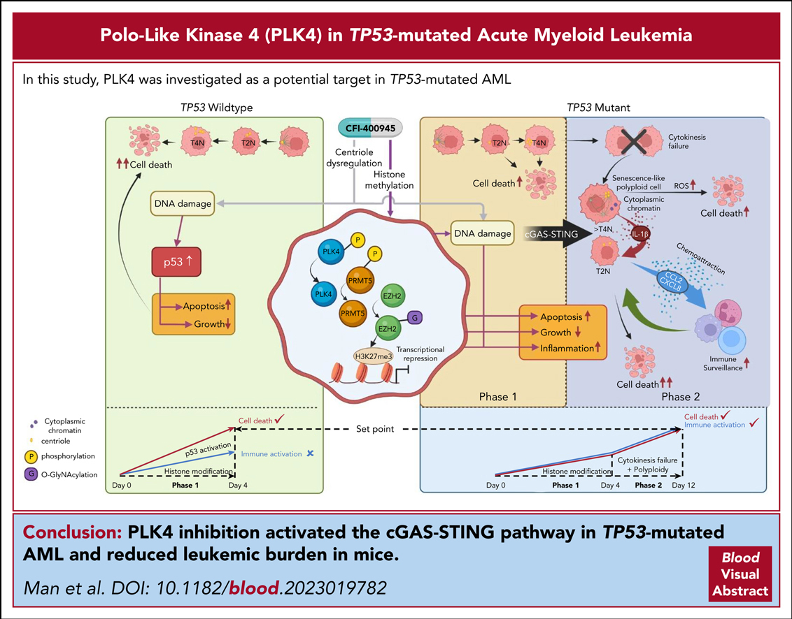
Inhibition of PLK4 remodels histone methylation and activates the immune response via the cGAS-STING pathway in TP53-mutated AML
Cheuk-Him Man,Wing Lam,Chee-Chean Dang,Xiao-yuan Zeng,Li-Chuan Zheng,Natalie Nok-Man Chan,Ka-Lam Ng,Koon-Chuen Chan,Tsz-Ho Kwok,Timothy Chi-Chun Ng,Wing-Yan Leung,Michael Shing-Yan Huen,Carmen Chak-Lui Wong,Chi Wai Eric So,Zhixun Dou,Susumu Goyama,Mark Robert Bray,Tak Wah Mak,Anskar Yu-Hung Leung, Inhibition of PLK4 remodels histone methylation and activates the immune response via the cGAS-STING pathway in TP53-mutated AML, Blood, 2023,
Copyright © 2023 American Society of Hematology
Notes:
Blood Research Article

Slide 6
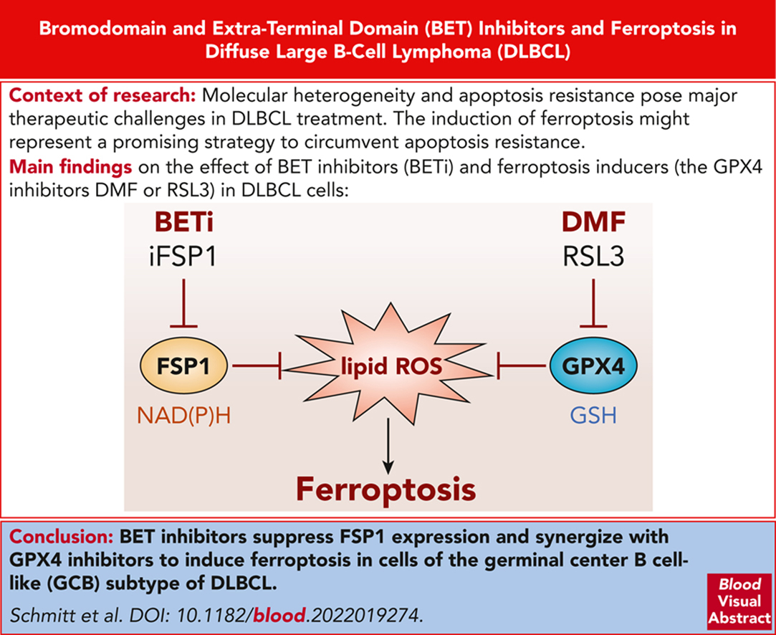
BRD4 inhibition sensitizes diffuse large B-cell lymphoma cells to ferroptosis
Anja Schmitt,Melanie Grimm,Nina Kreienkamp,Hannah Junge,Jan Labisch,Laurentz Schuhknecht,Caroline Schönfeld,Elsa Görsch,Alessia Tibello,Kerstin Menck,Annalen Bleckmann,Claudia Lengerke,Frank Rosenbauer,Michael Grau,Mattia Zampieri,Klaus Schulze-Osthoff,Pavel Klener,Alexandra Dolnikova,Georg Lenz,Stephan Hailfinger, BRD4 inhibition sensitizes diffuse large B-cell lymphoma cells to ferroptosis, Blood, 2023,
Copyright © 2023 American Society of Hematology
Notes:
Blood Research Article

